Slide 1
Decision Making with Mllib, Spark and SPARK streaming
Girish S Kathalagiri
Samsung SDS Research America

Slide 2
AGENDA
Introduction
Decision Making System: Intro and Algorithms
Decision Making System: Architecture and components

Slide 3
INTRODUCTION

Slide 4

SAMSUNG SDS
Samsung SDS is the enterprise solutions arm of the Samsung Group, with a major footprint in Asia and emerging presence in the US
Revenue (2014) $7.2B
Global Presence 47+ offices¹ in 30 countries
Employees 21,796
Market Position² No. 1 Korean IT services provider No. 2 largest IT service provider in the Asia-Pacific region (excluding Japan)
Source: 1 includes IT outsourcing and logistics offices, as of December 31, 2014 2 Market Share, Gartner, 2014 3 Expressed in U.S. dollars at exchange rate in effect on December 31 of respective year

Slide 5
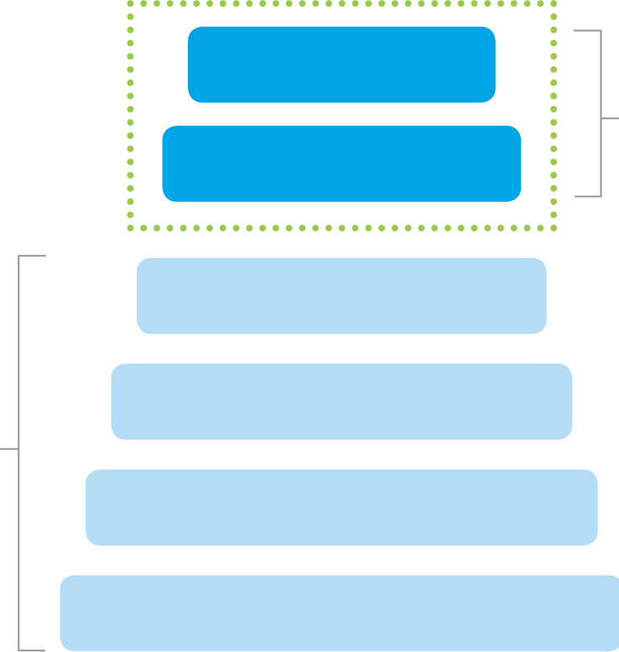
SAMSUNG SDS RESEARCH AMERICA
SDS Research America Focus
Decision
Decision Making
Recommendation
Insights
Model
Feature
Data
Notes:
Focus : Decision making algorithms and solutions using these algorithms.
Some of it we will be talking about through course of the presentation.

Slide 6
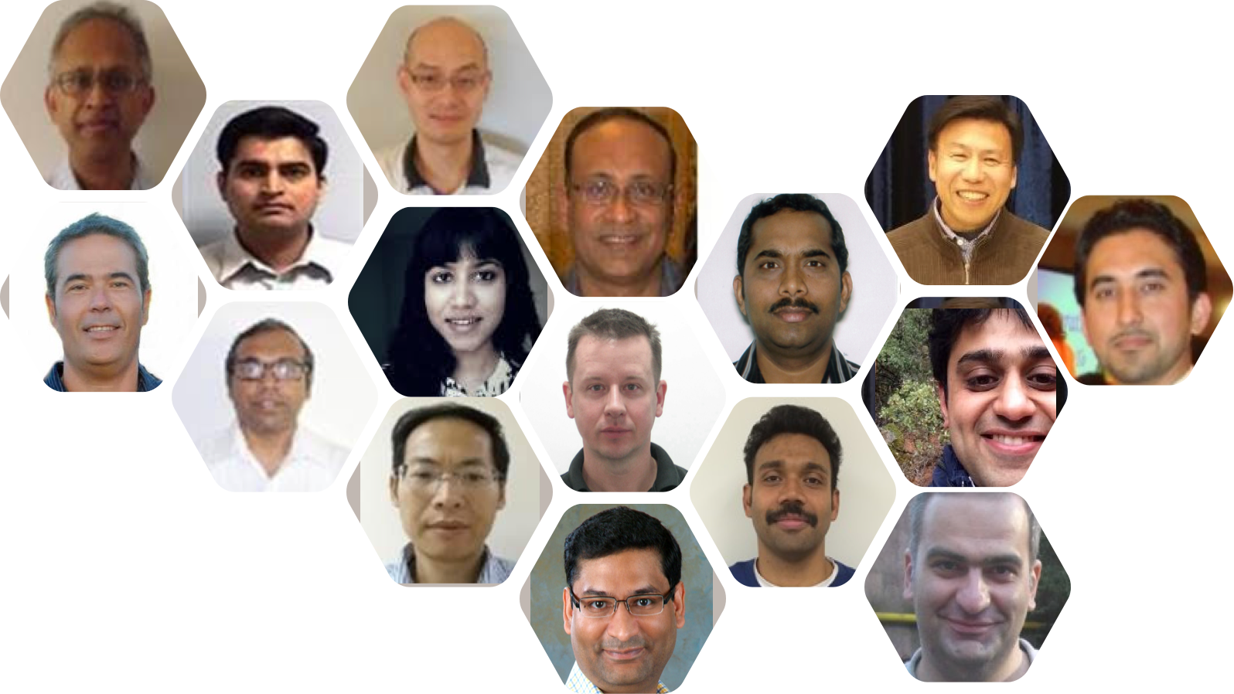
TEAM

Slide 7
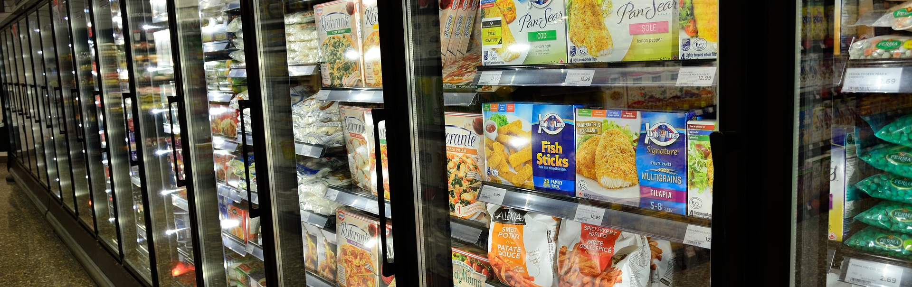
Decision Making System: Intro and Algorithm
Notes:
Lets first look at decision making in general and algorithms in this section

Slide 8

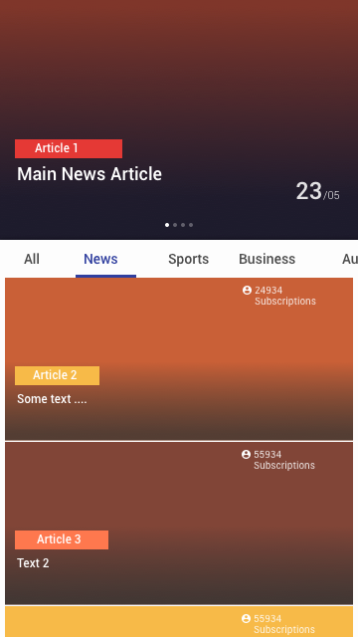
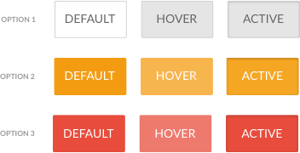
EXAMPLES of DECISION Making in online world
Ad Selection
News Article Recommendations
Website Optimization
Auction and real-time bidding.
Recommendation Systems.

Slide 9

TERMINOLOGY
Action/Arm
Reward
Set of options that are available for a problem.
Clicks, profit, revenue
Context
Side information that is available
Factors external to the system with which the agent is interacting
Environment
Software system that takes the decisions
Agent
Learning from interaction
Notes:
Learning from interaction

Slide 10

EXPLORATION vs EXPLOITATION TRADE off
Decision-making involves a fundamental choice
Exploitation :
Make the best decision with existing information that was collected.
Exploration :
Gather more information to see if there are better decisions that can be made.

Slide 11
EXPLORATION vs EXPLOITATION EXAMPLES
Cuisine selection:
Exploitation : favorite dish
Exploration : Try a new one
Game :
Exploitation : Play the best move (your belief)
Exploration : Try a new move
Online Advertising :
Exploitation : Show most successful ad
Exploration: Show a different ad
Restaurant Selection:
Exploitation : favorite restaurant
Exploration : Trying a new one

Slide 12
EXPLORATION vs EXPLOITATION TRADE off
Area | Exploration | Exploitation
Economics | Risk-Taking | Risk-Avoiding
Finance | Investing | Saving
Marketing | Diversification | Concentration
Medicine | Experimental treatment | Safety and efficacy
Notes:
Fields

Slide 13
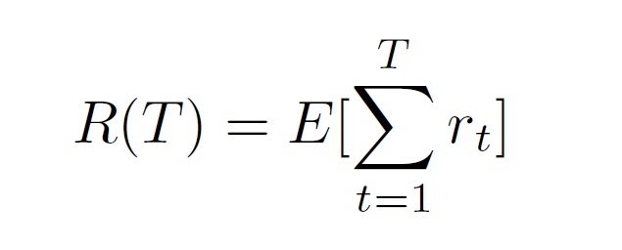
CUMMULATIVE REWARD
Objective : Maximizing the Expected Cumulative Reward

Slide 14
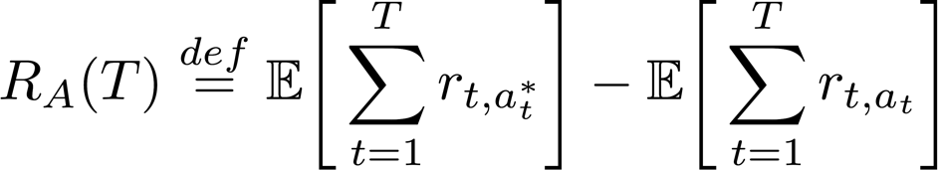
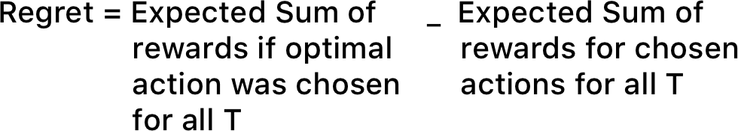
REGRET
Objective : Minimize the Regret , over time horizon T

Slide 15
CHARACTERISTICS OF LEARNING WITH INTERACTION
Agent Interacts with the environment to gather more data
Agent performance is based on Agent’s decision
Data available to Agent to learn is based on its decision

Slide 16

Multi ARMED BANDIT
[Robbins ‘52]
Notes:
Imagine a casino setting …
Also, K-armed bandit problem where a Gambler is faced with set of slot machines with different payout distributions.
At each time Gambler has to choose an arm , which pays out some reward.
Objective : To maximize the sum of rewards earned in a sequence of lever pulls.

Slide 17
Multi-armed bandit
Set of K arms ( actions, choices , options )
At each time step t = 1 .. N
Agent selects an arm
Receives a reward from the environment
Agent updates the belief about the arms (estimates the value).
How does Agent selects the arm at any point of time ?
Notes:
Little more formal definition.

Slide 18
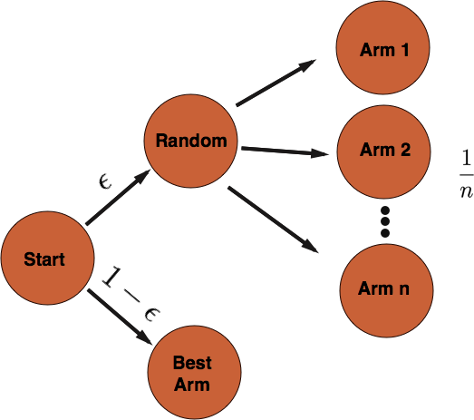
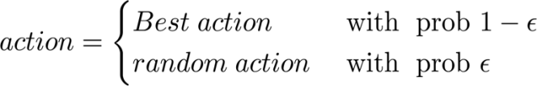
Multi-armed bandit : EPSILON - GREEDY
Greedy (Exploit) : Highest estimated reward
Epsilon (Explore ) : Random choice
Dealing with Epsilon:
Constant epsilon value (Epsilon Greedy Strategy)
Epsilon-Decreasing Strategy
Epsilon-First Strategy

Slide 19
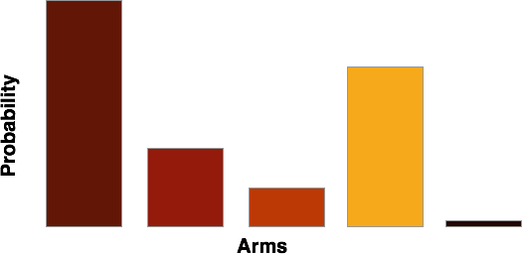
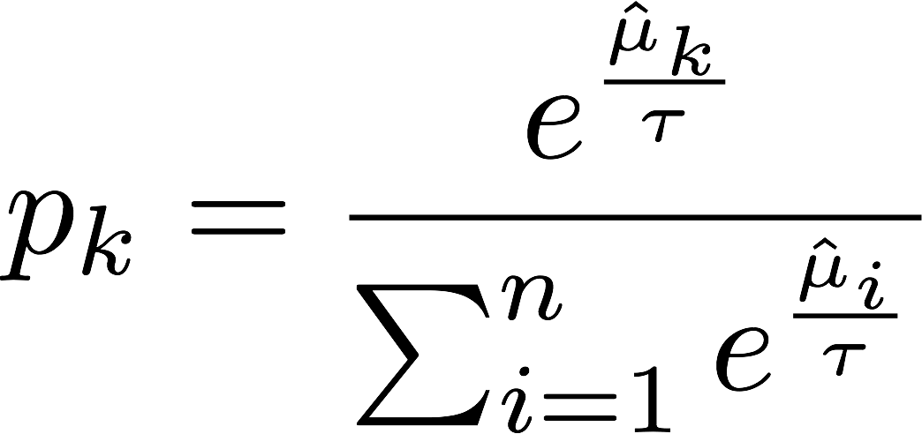
Multi-armed bandit : SOFTMAX
Epsilon-Greedy is relatively insensitive towards relative performance levels
Arms 0.99 vs. 0.01 and 0.52 vs. 0.48
Softmax Strategy (Structured Exploration)
Chooses the arm proportional to the estimated value of arms
What if the initial few exploration was not so rewarding ?
Notes:
Under explore the options that initially gave less reward.

Slide 20
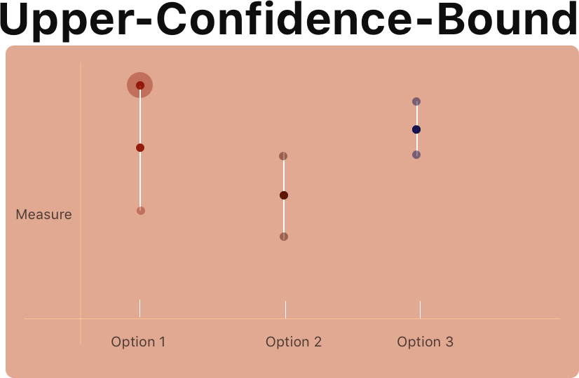
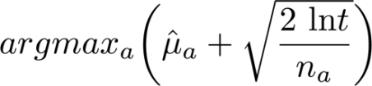
Multi-armed bandit : Upper Confidence bound (UCB)
Take action that has best estimated mean reward plus confidence
Environment generates reward
Agent Updates its expected mean reward and confidence interval.
Optimism in the face of uncertainty
[Auer ’02]

Slide 21
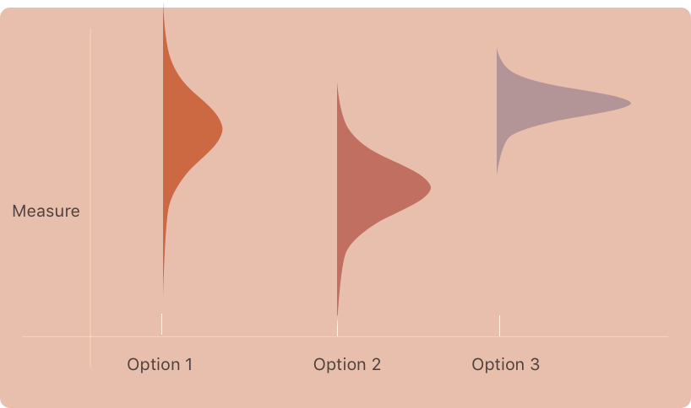
Multi-armed bandit : Thompson sampling
For each arm, sample parameter from Beta distribution.
Choose the arm that has maximum reward for the chosen parameter.
Environment generates reward
Agent Updates the distribution for the arm.
[Thompson 1993]

Slide 22
Stream Processing of Multi-armed bandit
Data (t-1)
Data (t)
Data (t+1)
Epsilon Greedy : estimate mean rewards for each arm
Softmax : estimate mean rewards for each arm , calculate softmax
Upper Confidence bound : estimate mean and confidence interval
Thompson Sampling : Update the parameters of beta dist.
Update stats for arms
Update stats for arms
Update stats
Arm
stats (t-1)
Arm
stats (t)
Arm
stats (t)
Time

Slide 23

Contextual Multi-armed bandit
For t = 1, . . . , T:
The Environment request with some context x_{t} ∈ X
The Agent chooses an action a_{t} ∈ {1, . . . ,K} for the context
The Environment reacts with reward r_{t}(a_{t})
The Agent updates the model
Goal : Best action for the context.
[Auer-CesaBianchi-Freund-Schapire ’02]
Notes:
the Agent’s aim is to collect enough information about how the context vectors and rewards relate to each other, so that it can predict the next best arm to play by looking at the feature vectors

Slide 24



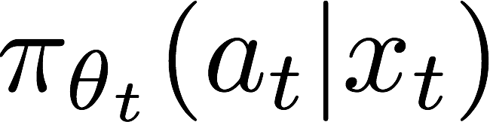

Optimization
Initialize Model Parameter
Repeat {
Using data, update the model parameters
} until convergence
Notes:
More explanation …..
----- Meeting Notes (5/22/16 20:01) -----
Iterative jobs and In Memory Computing....
Moves to optimal value.

Slide 25
ONLINE and batch learning
Online Learning (Stream Processing)
Batch Learning
Initialize Parameters
Initialize Parameters
Data (t-1)
Quick update on Parameters
Learn Model Parameters
Faster Learning ,Approximation
Vs
Long term trends , Accurate Learning
Data (t)
Update parameters from prev mini-batch
All the training
data
Data (t+1)
Update parameters from prev mini-batch
Notes:
Challenges that are presented by these algorithms
Lambda Architecture

Slide 26
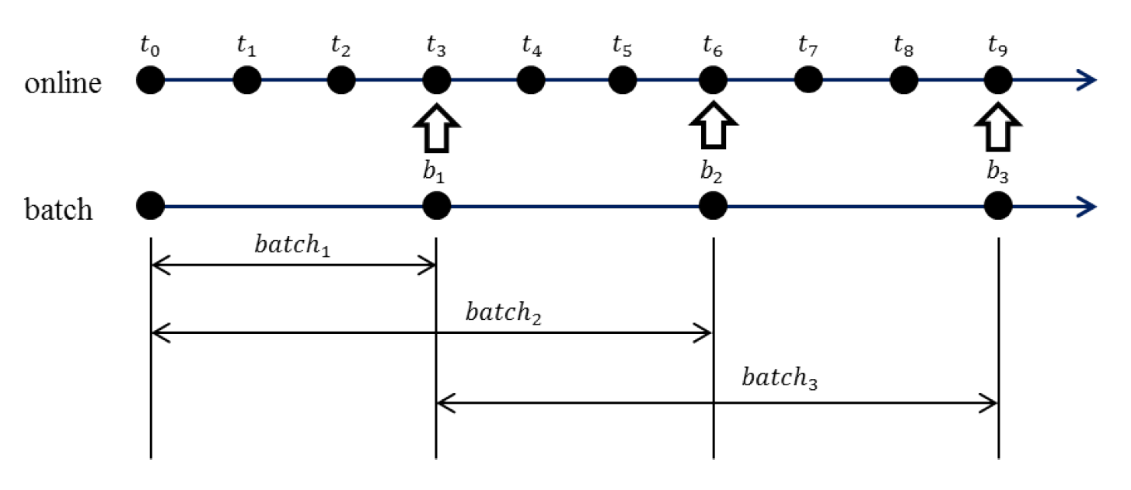
TIMESCALEs FOR LEARNING
Algorithms for Contextual Multi-armed Bandit
LinUCB [ Li et al 2010]
Thompson Sampling with Logistic Regression[Chapelle and Li 2011 ]
Notes:
Sliding window on the data , so that we can decrease the influence of historical data.
New article example ..

Slide 27
Decision Making System: Architecture and components

Slide 28





SOFTWARE STACK
Real time decision making
Scalable System
Batch and Online Learning
Analytics Framework

Slide 29
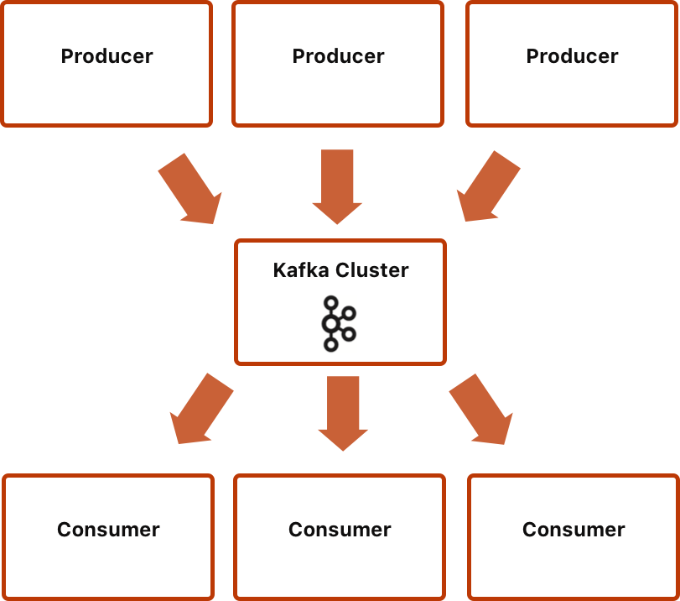
KAFKA : Distributed Messaging system
Distributed by design (Fault tolerant).
Fast and Scalable.
High throughput for both publishing and subscribing.
Multi-subscribers.
Persist messages on disk : batched consumption as well as real time applications.
http://kafka.apache.org/

Slide 30
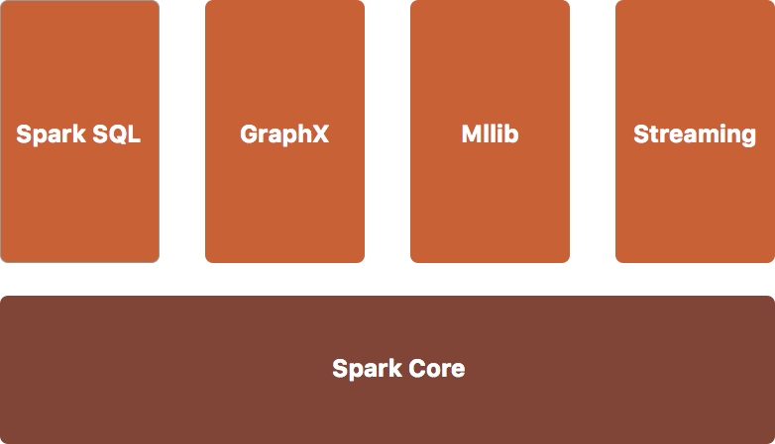

SPARK and SPARK STREAMING
High volume data processing for feature extraction as a means of modeling business environment state;
Model training on historical events
Stream processing for Online updates
Machine Learning Library
http://spark.apache.org/

Slide 31
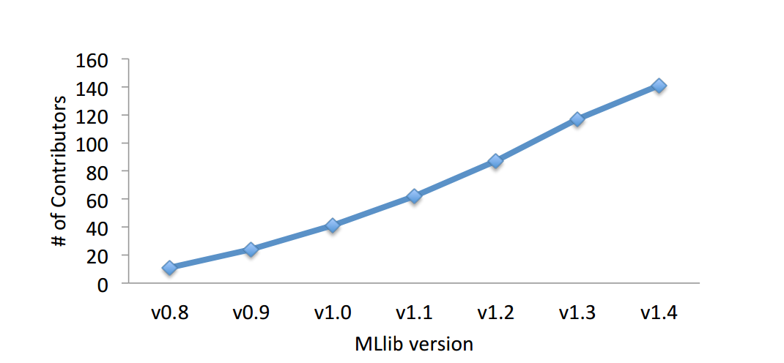
MLLIB : Machine Learning Library
Spark Integration
Distributed Machine Learning Algorithms
Algorithmic Optimization
High and Developer APIs
Community
Basic Statistics
Classification and
Regression
Collaborative filtering
Summary Statistics
Correlations
Stratified Sampling
Hypothesis testing
Random Data Generator
Linear Models ( SVM, logistic regression )
Naïve bayes
Tree based models ( GBT, RF, DT)
Alternating
Least
Squares
(ALS)
Clustering
Dimensionality Reduction
Optimization
K-means
Gaussian Mixture
Power iteration clustering
Latent Dirichlet allocation
Streaming k-means
Singular value decomposition
(SVD)
Principal component analysis
(PCA)
Stochastic gradient descent
(SGD)
Limited-memory BFGS
(L-BFGS)
http://www.jmlr.org/papers/volume17/15-237/15-237.pdf

Slide 32
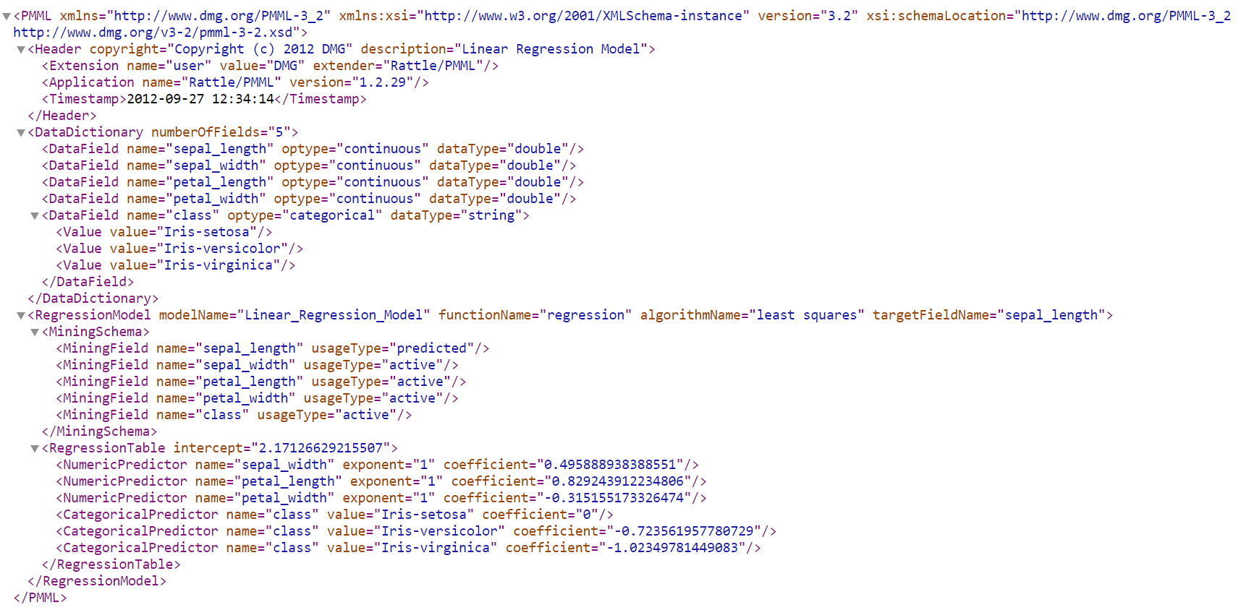

Model Storage
Hbase
Models stored in PMML format.
Import and Export from external system
Model metrics and statistics are stored.
Configuration information of the system.
http://dmg.org/pmml/pmml_examples/index.html

Slide 33
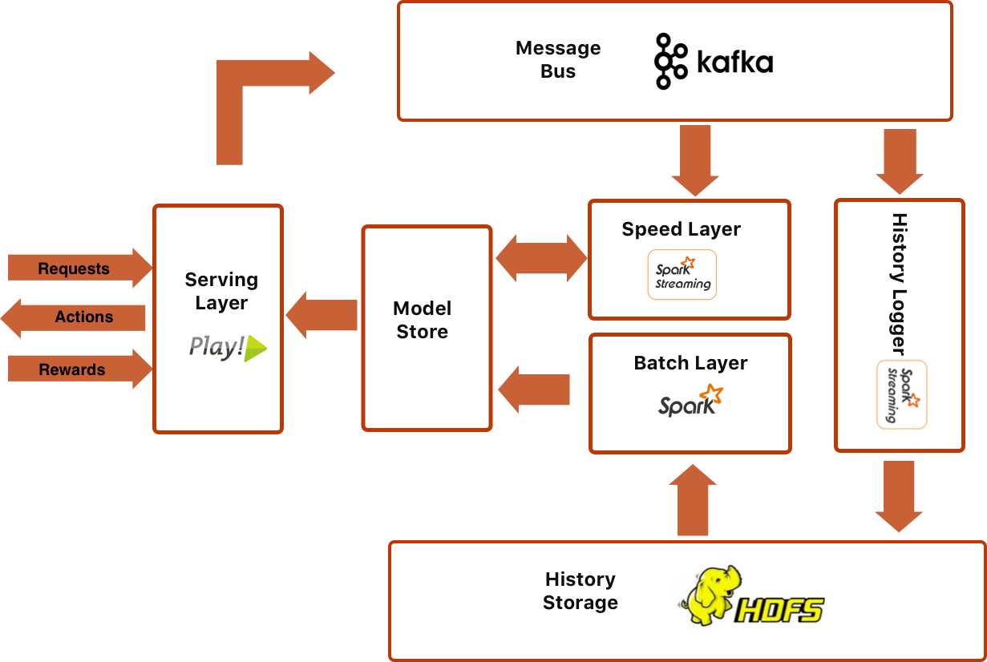
LAMBDA Architecture

Slide 34
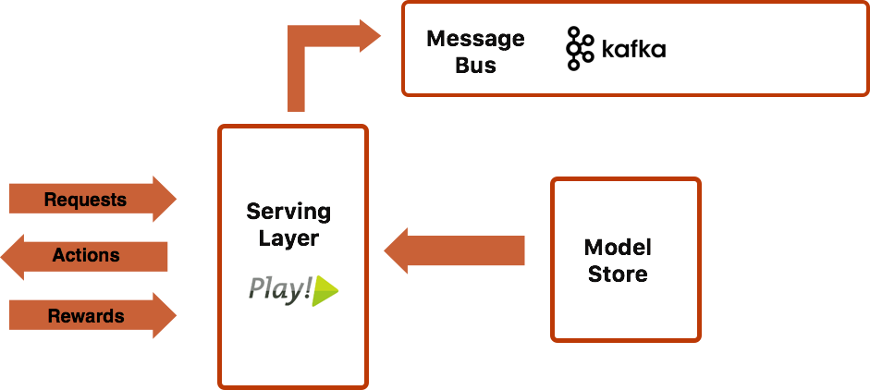
SERVING LAYER
PLAY Framework
Interfacing with external system
Low Latency
Mechanism for Multiple Models.
Processes Request and Reward messages.
Retrieves Model from Model store and caches.
Logs the messages to Kafka topic.

Slide 35
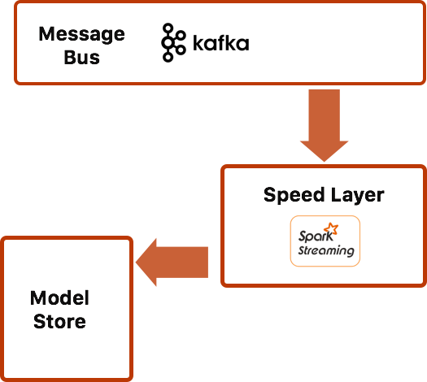
SPEED LAYER
Spark streaming application
Receives messages from Kafka in micro batches for processing.
Latest model from Model Store and updates and stores the model.
Notifies the Model update to serving layer.

Slide 36
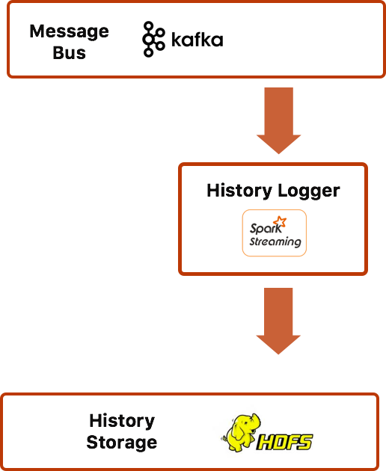
HISTORY LOGGER
Spark Streaming application
Kafka consumer.
Archives messages logged by serving layer
HDFS long term storage.
Archived data used by batch layer.

Slide 37
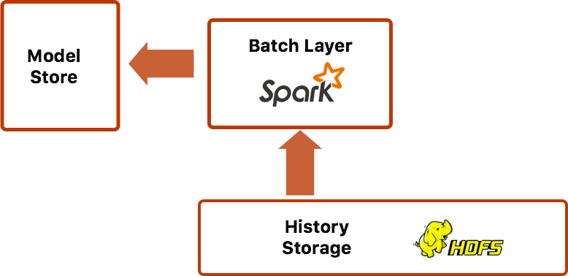
BATCH LAYER
Spark application
Reads the historical archived data.
Configured sliding window.
Generates training data
New Model from scratch.
Stores it into Model Storage

Slide 38
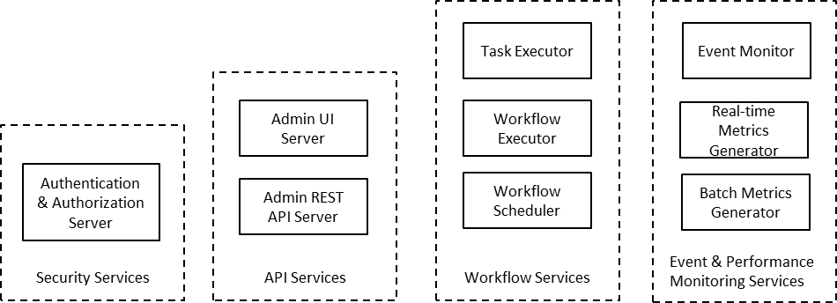
MANAGEMENT SERVICES
Suite of application
Configuration of the system
Monitoring the processes
Administrative UI
Authorization and Role based access control.
Scheduling of workflows

Slide 39
LAMBDA Architecture

Slide 40
RECAP
Decision making algorithms that has Exploration vs Exploitation tradeoffs
Multi-armed bandit and Contextual Multi-armed bandit algorithms.
Lambda architecture

Slide 41
QUESTIONS ?

Slide 42
REFERENCES
A contextual-bandit approach to personalized news article recommendation; Lihong Li, Wei Chu, John Langford, Robert E. Schapire
Generalized Thompson Sampling for Contextual Bandits; Lihong Li
Big Data: Principles and best practices of scalable realtime data systems. Nathan Marz & Warren J.
Data Mining Group. Predictive Model Markup Language.
Taming the Monster: A Fast and Simple Algorithm for Contextual Bandits ; Alekh Agarwal, Daniel Hsu, Satyen Kale, John Langford, Lihong Li, Robert E. Schapire
Unbiased Offline Evaluation of Contextual-bandit-based News Article Recommendation Algorithms; Lihong Li, Wei Chu, John Langford, Xuanhui Wang
Reinforcement Learning: An Introduction ; Richard S. Sutton ,Andrew G. Barto

